Slide 1

Aadhar seeding status of Madhya pradesh
.

Slide 2
INTRODUCTION
Aadhaar seeding status refers to the process of linking an individual's Aadhaar card with various government and financial service accounts. It helps in authentication, verification, and delivery of government subsidies and services, promoting transparency and reducing fraud. Monitoring Aadhaar seeding status is crucial for efficient service delivery and social welfare programs.

Slide 3
DATA INSIGHTS
1) District
2)No. of eligible families
3)Eligible families with Aadhar
4)Eligible families without Aadhar
5)Eligible families with Aadhar in percentage
6)No. of eligible population
7)Eligible population with Aadhar
8)Eligible population without Aadhar
9)Eligible population with Aadhar percentage
10)Aadhar Enrollments in State as on 29-05-15

Slide 4
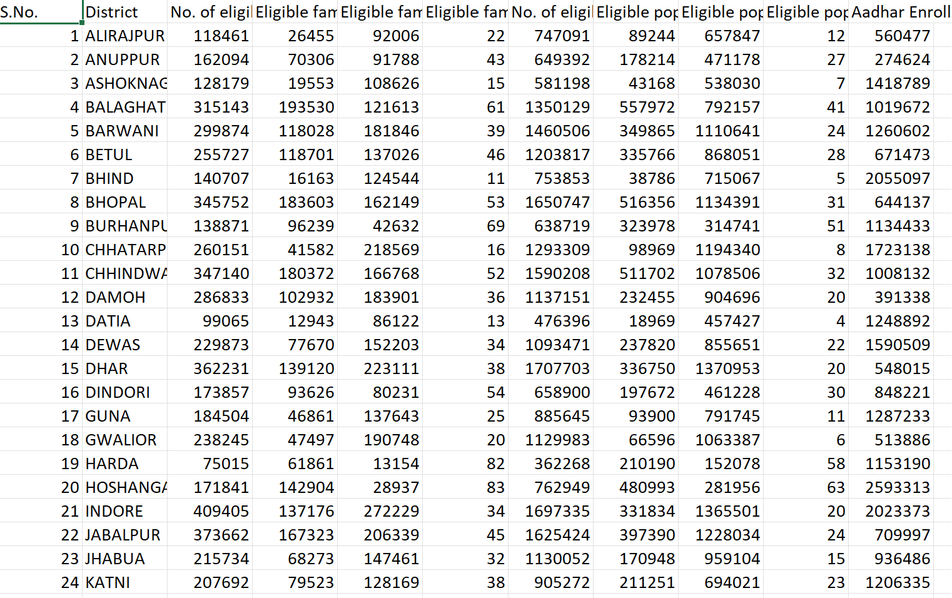
DATASET

Slide 5
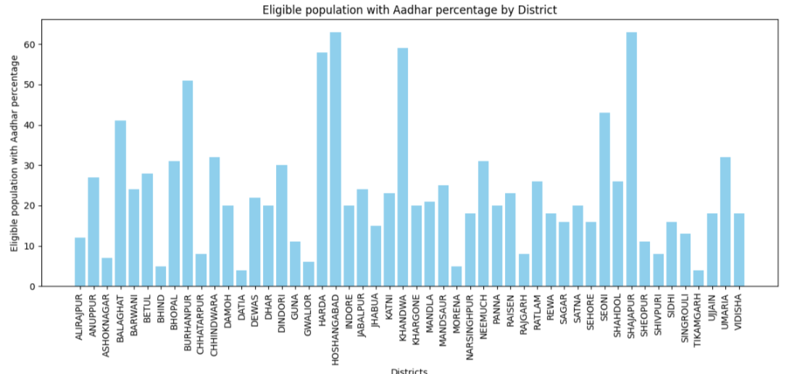
GRAPH

Slide 6
MACHINE LEARNING MODEL
SUPERVISED LEARNING:
Supervised learning is defined as it is a type of machine which is used for labelled data i.e where there are predicted values(y-values) exist in a data.Supervised learning infers a function from labelled training data consisting of a set of training examples .This is used for prediction and has a feedback mechanism..
The data set of “Aadhar seeding status of Madhyapradesh” is being trained and tested using LOGISTIC REGRESSION

Slide 7
THE MACHINE LEARNING MODEL USED
LOGISTIC REGRESSION:-
Logistic regression is a supervised machine learning algorithm mainly used for classLification tasks where the goal is to predict the probability that an instance of belonging to a given class or not. It is a kind of statistical algorithm, which analyze the relationship between a set of independent variables and the dependent binary variables. It is a powerful tool for decision-making.

Slide 8
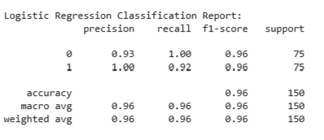
OUTPUT

Slide 9
SVM(Support Vector Machine)
The aim of a support vector machine algorithm is to find the best possible line, or decision boundary, that separates the data points of different data classes. This boundary is called a hyperplane when working in high-dimensional feature spaces. The idea is to maximize the margin, which is the distance between the hyperplane and the closest data points of each category, thus making it easy to distinguish data classes.

Slide 10
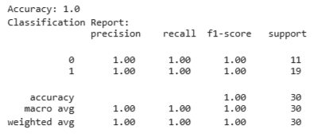
OUTPUT

Slide 11
PERCEPTRON
Perceptron is Machine Learning algorithm for supervised learning of various binary classification tasks. Further, Perceptron is also understood as an Artificial Neuron or neural network unit that helps to detect certain input data computations in business intelligence.

Slide 12
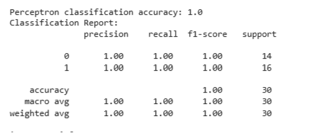
OUTPUT

Slide 13
LASSO REGRESSION:
Lasso regression, short for "Least Absolute Shrinkage and Selection Operator," is a linear regression technique that adds a penalty term to the loss function, promoting feature selection by shrinking some coefficients to zero. It helps prevent overfitting and simplifies the model.

Slide 14
REIDGE REGRESSION:
Ridge Regression is a linear regression technique that introduces L2 regularization by adding a penalty term to the least squares objective, helping prevent overfitting in the presence of multicollinearity.

Slide 15
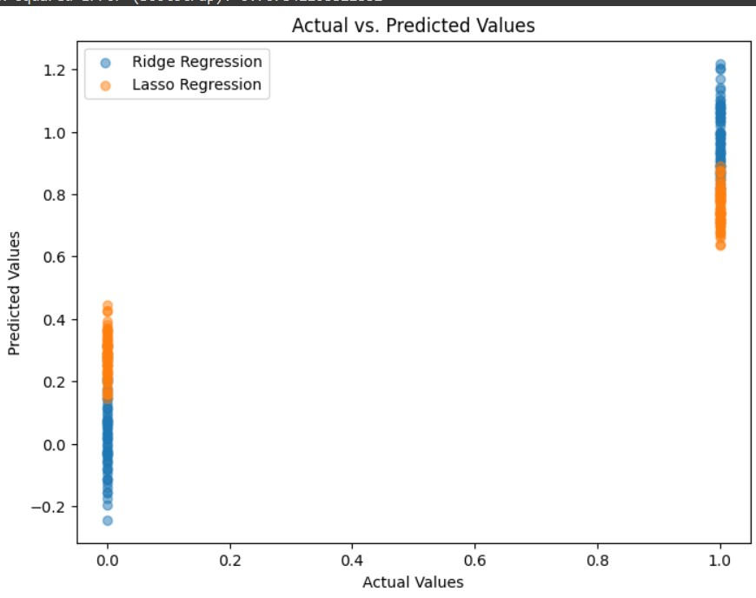
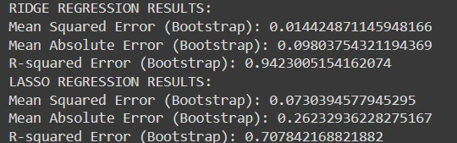
OUTPUT OF LASSO AND RIDGE REEGRESSION:

Slide 16
KNN REGRESSION:
k-Nearest Neighbors (k-NN) regression is a supervised machine learning algorithm that predicts the target value of a data point by averaging the values of its k nearest neighboring data points. It's used for regression tasks to estimate numerical outcomes based on the similarity of neighboring data points.

Slide 17
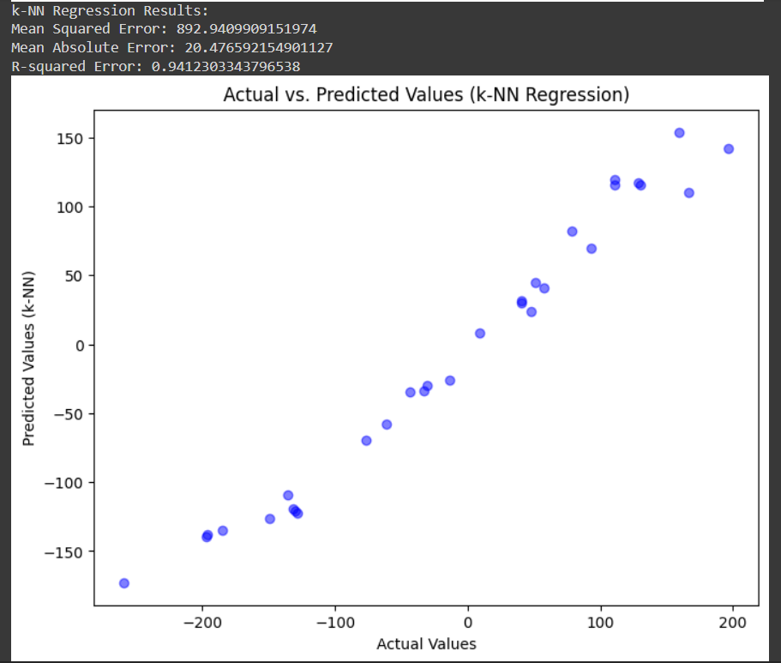
OUTPUT:

Slide 18
GITHUB LINK:
https://github.com/sricharanmartha/STAT-ML-PROJECT-REVIEW-2.git

Slide 19
USER DETAILS
M. Sri Charan 2203A52101
TRAINER:
Mr. D. Ramesh
Asst. professor
CS and AI&ML

